Slide 1

P&G Data Science Case – Product Strategy Insights
Ayyub Orujzade
Bhupender Bhupender
May 2025

Slide 2
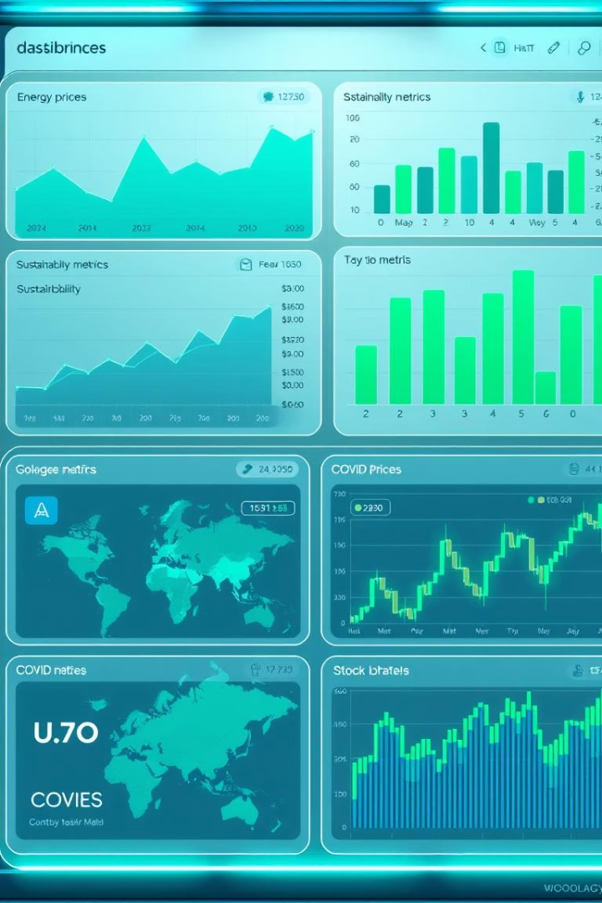
Introduction
Project Objective
Goal
Recommend strategies aligned with consumer behavior and ESG goals.
Explore product strategy through data on energy, sustainability, COVID, and stocks.
Hypotheses
Test COVID impact on stock price, ESG consumer impact, ESG data gaps.

Slide 3

Hypothesis 1: COVID vs Stock Price
Claim
Significance
No correlation between COVID cases and P&G stock price.
Market confidence during a public health crisis impacts investor behavior.
Context
COVID caused global uncertainty affecting stock markets worldwide.

Slide 4

Hypothesis 1: Methodology
Data Sources
COVID-19 weekly new cases (U.S.) and P&G stock prices (2017–2025).
Preprocessing
Aligned data by Sundays and filtered to COVID date range.
Analysis
Applied Pearson and Spearman correlation tests for relations.

Slide 5
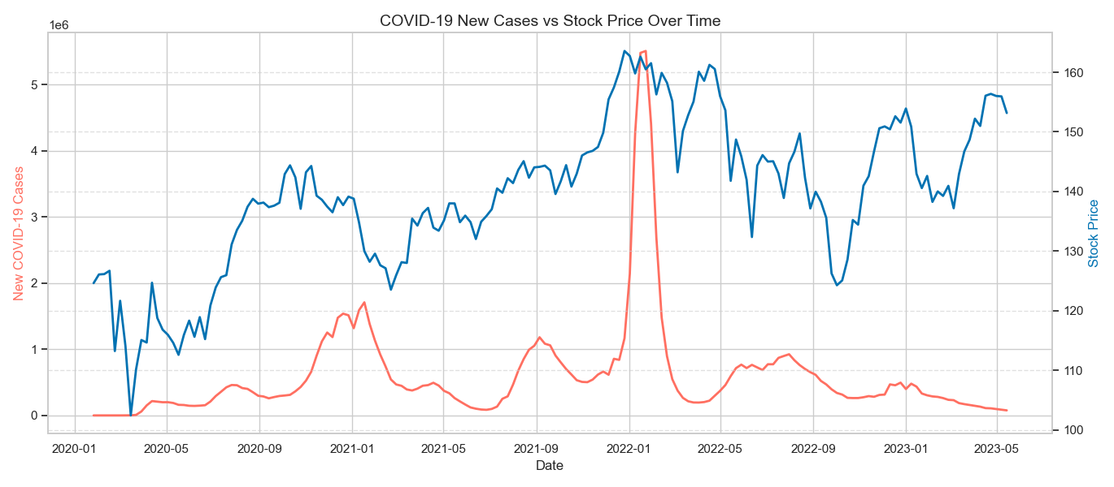
Data Visualization

Slide 6
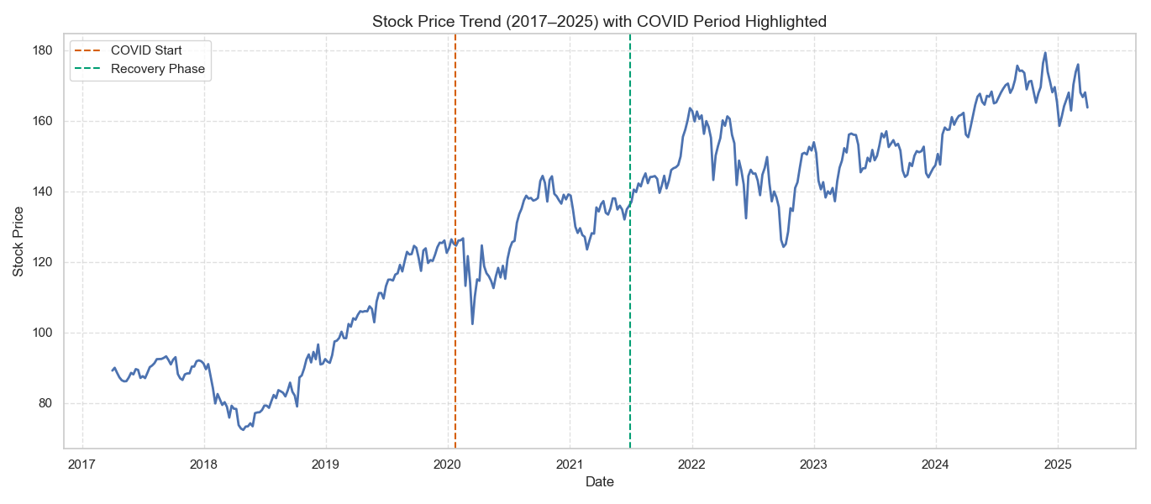
Data Visualization

Slide 7
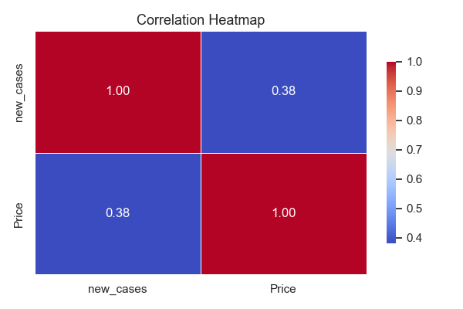
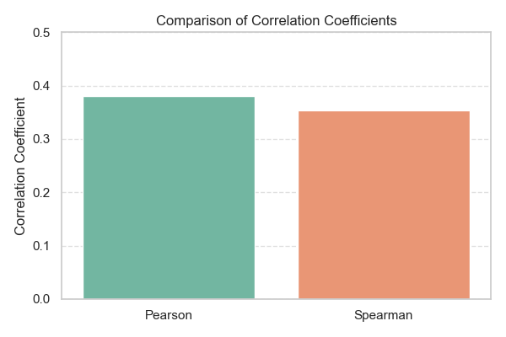
Correlation results

Slide 8
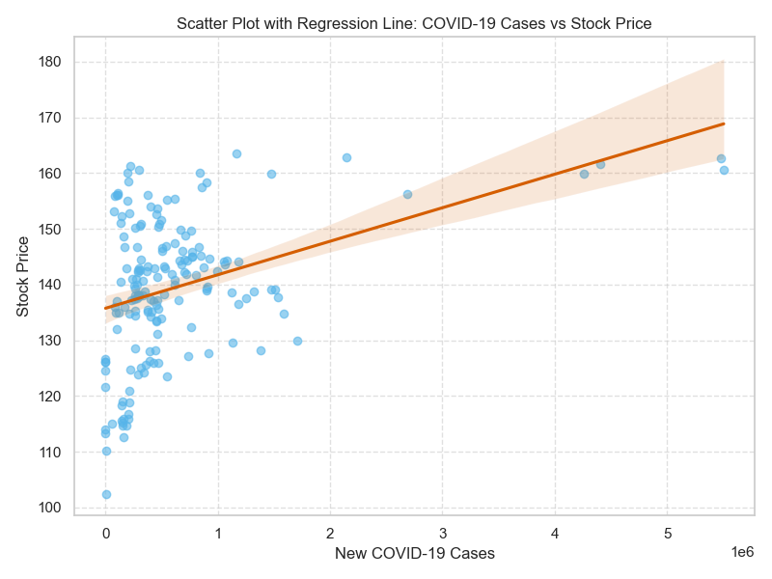
Data Visualization

Slide 9



ESG Strategy Insights
Hypothesis 2
ESG strategy impact on consumers
Hypothesis 3
ESG data gaps for targeting

Slide 10
Hypothesis 2: ESG & Consumer Impact
Statement
Importance
ESG improvements do not reduce consumer satisfaction or demand.
Supports P&G's goal to lead in sustainability without harming sales.

Slide 11

Hypothesis 2: Methodology
Data Collected
CO₂ emissions, water consumption, plastic waste metrics over years and countries.
Approach
Cleaned and aligned data; compared sustainability trends to consumer metrics.

Slide 12
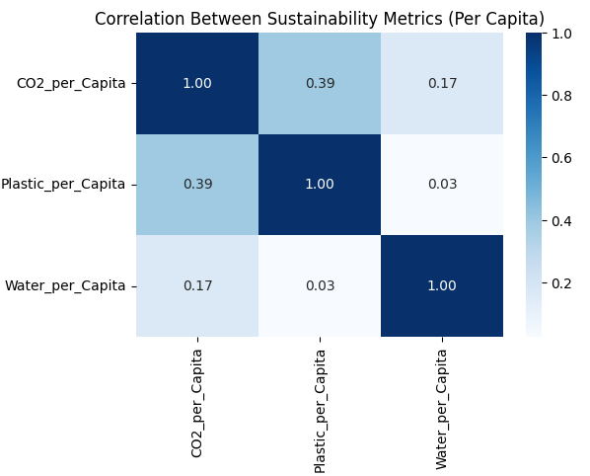
ESG Trends & Metrics

Slide 13
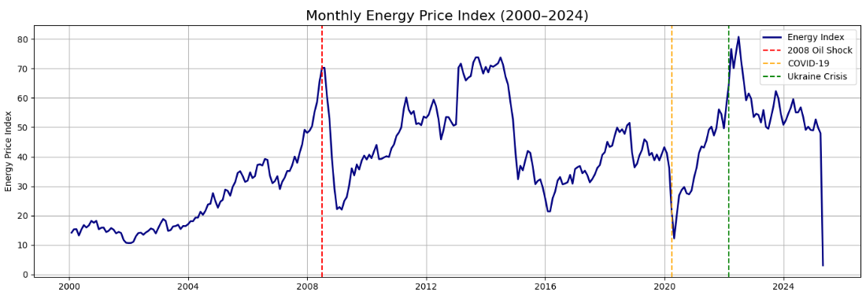
Energy Sensitivity

Slide 14
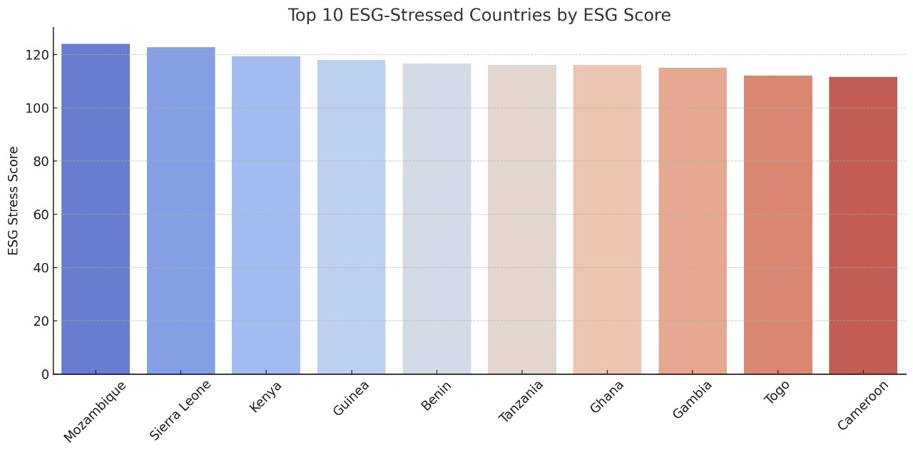
Bar chart of top ESG-stressed countries

Slide 15
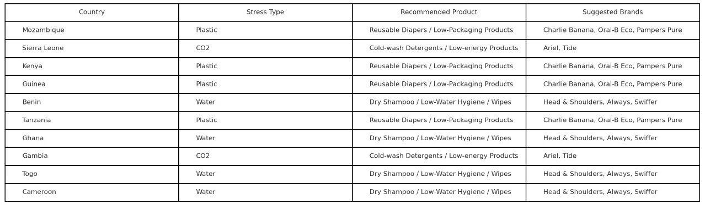
Product strategy mapping table

Slide 16
Hypothesis 2: Conclusion
Findings
Conclusion
ESG improvements show no negative consumer effects; potentially positive.
Supports hypothesis: ESG strategy is neutral or enhances consumer experience.

Slide 17
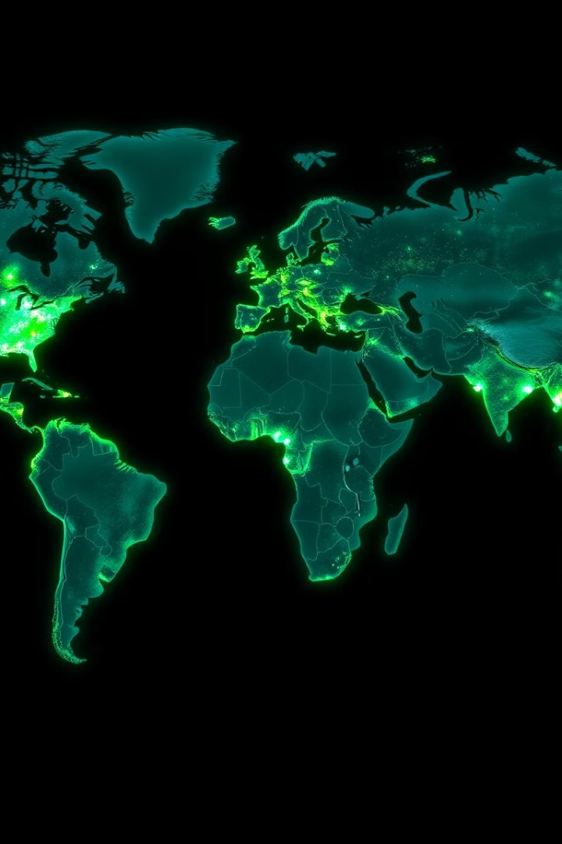
Hypothesis 3: ESG Data Gaps
Claim
Insufficient data to recommend ESG focus areas by product or region.
Significance
Accurate targeting requires granular, region-specific ESG data.

Slide 18

Hypothesis 3: Data Analysis
Analysis
Reviewed ESG data for regional, temporal, and product relevance gaps.
Findings
Most data lacks product-region granularity; highly aggregated overall.

Slide 19

Hypothesis 3 Conclusion: Need for Granular ESG Data
Generalized ESG Data
Hypothesis Confirmed
Lacks precision for strategic targeting and actionable insights.
More granular, product-level, and localized ESG metrics are essential.
Action Recommended
Invest in enhanced ESG data collection for refined strategy formulation.

Slide 20

Final Recommendations for P&G Stakeholders
ESG Integration
Continue without consumer impact, ensuring brand alignment.
Stock Resilience Focus
Emphasize product hygiene and stability during disruptions.
Data Granularity
Enhance ESG metrics to unlock precise 'where to play' insights.
Real-time Feedback
Implement product-specific feedback mechanisms for agility.

Slide 21
THANKS FOR YOUR ATTENTION !

